Slide 1


Designing a marketing mix model for Dalmia Cement
R. Jeya Sri (13MBA033)
Guided by : Dr. J. Praveen Paul
Mepco Schlenk Engineering College, Sivakasi

Slide 2
Problem Statement
Dalmia cement is a client of Leo Burnett, Chennai.
Even though advertisements and promotional schemes were modified the downstream supply chain was not able to help in the product movement .
This study aims at identifying the opinions of the home builders, Dalmia cement dealers, Dalmia cement non-dealers and the influencers to find what hinders the downstream supply stream in triggering the product movement.

Slide 3
Objectives
To analyze the factors affecting cement Home builders’ general opinion, expectations over cement and their opinion about Dalmia.
2. To analyze the opinion of Dalmia non-dealers over
Dalmia.
3. To analyze the factors affecting the general opinion
and expectations over cement of Influencers and
particularly their opinion about Dalmia.

Slide 4
Objectives
4. To analyze the factors affecting cement Dalmia
cement dealers’ general opinion, expectations over
cement and particularly their opinion about Dalmia.
5. To develop a marketing mix model for Dalmia using
the collective findings obtained from Home builders,
Influencers, Dalmia dealers and Dalmia non-dealers
cement.

Slide 5
Scope
This study was conducted in Chennai covering around 59 areas.
Respondents | Count
Home builders | 30 people
Dalmia cement dealers | 40 people
Dalmia cement non-dealers | 20 people
Influencers | 14 people

Slide 6
Research Methodology
SAMPLE SIZE | 104
SAMPLING TYPE | Convenience sampling within Area sampling
SAMPLING LOCATION | 59 areas in Chennai (including urban and sub-urbs)
DATA COLLECTION METHODS | Direct Interview (Structured Questionnaire) Phone Interview (Structured Questionnaire) Casual Conversation ( Unstructured )
DATA ANALYSIS TOOLS | Cross tabs Chi-square test Weighted average Frequency analysis (Single and multiple responses) Regression (Simple linear and multiple) Correlation Mean Rank Non parametric tests (Kruskal Wallis & Man whitney U )

Slide 7
Objective 1 - Findings
77% of dealers displayed point of purchase ads.
Small scale dealers are more interested in pushing the C grade cement brands.
97.5% dealers find it easy to acquire Dalmia dealership.
7.3% dealers have quitted the dealership in past 2 years
7.5% dealers were not called for dealer meeting.
20% of the dealers follow JIT approach.
15% of the dealers do advertising.

Slide 8
Objective 1 - Findings
82.5% dealers have received the marketing assistance from the company and among them 92.5% dealers find it satisfactory and the rest 7.5% wants it to be provided regularly.
60% of the dealers have high demand for Dalmia
25% of the dealers are found to personally recommend Dalmia to the customers.
50% of the customers are found to be particularly asking for Dalmia.

Slide 9
Objective 1 - Findings
7.5% of the dealers doesn’t get stock delivered on time and 5% of the dealers find it unfavorable to make changes in the order.
82.5% dealers had sufficient stock at the time of their highest orders.
Dealers’ overall favorableness ranking
Ultratech
Coromandel
Priya
Dalmia
Ramco (A.Tool : Weighted Average)

Slide 10
Objective 1 - Findings
There is positive relationship between
years of dealership with Dalmia and dealer meetings conducted
years of dealership with Dalmia and highest order placed in a single lot.
responsive communication from company, dealer problem addressing nature of the company, technical support provided by the company, trade promotions, the allowances provided by Dalmia.
the dealership satisfaction, market assistance satisfaction, order changing satisfaction, timely stock delivery satisfaction and the overall dealership satisfaction. (A.Tool : Correlation )

Slide 11
Objective 1 - Findings
There is no significant difference between
the size of firm and the people preference of Dalmia.
the size of firm and the willingness to continue dealership
the size of firm and the frequency of dealership meetings being called for.
the size of the and the POS materials displayed.
the size of the and the frequency of advertisements made by them.
the size of the and the sufficient stock availability
(A.Tool : Kruskall walli’s Test & Man Whitney’s Test)

Slide 12
Objective 1 - Findings
There is no significant cluster groups available among the dealers with respect to their dealership experience, highest order received on a single lot and stock capacity
(A.Tool : Cluster Analysis )
There is significant difference between
the size of the firm and the demand for Dalmia.
the size of the firm and the marketing tips provided.
(A.Tool : Kruskall walli’s Test & Man Whitney’s Test)

Slide 13
Objective 2 - Findings
50% of the dealers have received demand for Dalmia and 35% of the dealers are willing to stock Dalmia in future.
Top 5 fast moving brands are
Coromandel
Ultratech
Priya & Mahashakthi
Penna
Ramco & Zuari (A.Tool : Weighted Average)

Slide 14
Objective 2 - Findings
Reason for willingness to stock :
Demand is there is retail
Incentives are good
Wishing to expand
Reason for unwillingness to stock :
No frequent demand
Profit margin is less
Doing in small scale only

Slide 15
Objective 2 - Findings
There is relationship between the
dealership experience and the willingness for future dealership.
earlier demand and the willingness for future dealership. (A.Tool : Correlation )

Slide 16
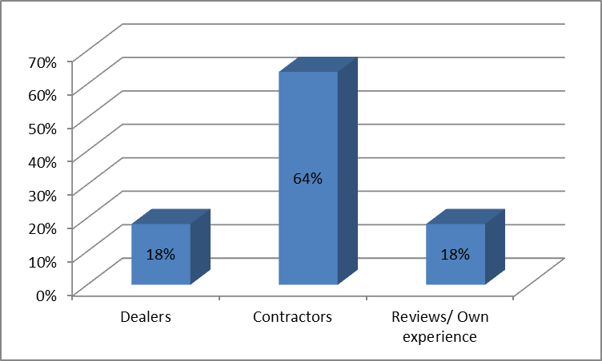
Objective 3 - Findings
Source of influencers’ suggestion

Slide 17
Objective 3 - Findings
Prioritized considerations of influencers
Quality
Expert opinion
Availability
Price
Application and grade available
Freight Charges
Company assistance & VA services
Brand image
Psychological reasons
Brand ambassador (A.Tool : Weighted Average)

Slide 18
Objective 3 - Findings
Long life time & Smooth finish are given more priority than less setting time. Dalmia’s average rating in these aspect is Good.
.
Top 5 favorable brands are
Ultratech
Coromandel
Zuari
Dalmia
Ramco (A.Tool : Weighted Average)

Slide 19
Objective 3 - Findings
There is significant difference between the designation of the influencers and the tie ups with the dealers.
There is no significant difference between
the designation of the influencers and the preference of Dalmia
the designation of the influencers and the alternative cement preferred by the influencer.

Slide 20
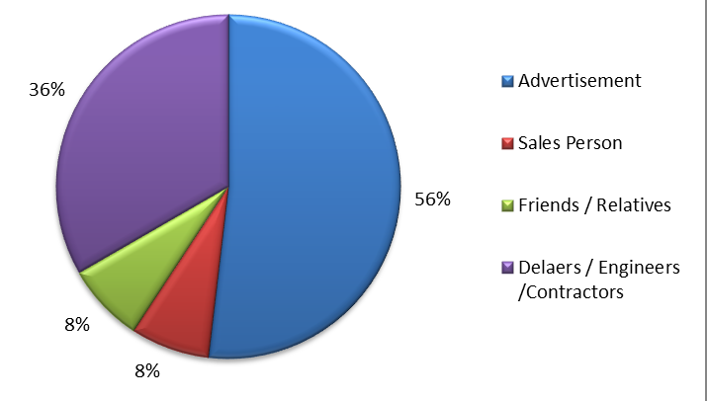
Objective 4 - Findings
Brand Awareness source

Slide 21
Objective 4 - Findings
Using Dalmia for floors/roof alone and choosing low cost cement for walls.
Switching to substitute brand due to lack of availability.
Not willing to opt Dalmia due to relatives/friends being other close substitute cement’s dealer or psychological reasons like being used up to an usual brand.
When people mention Ultratech they address it as L&T cement and were not aware of that, that its not owned by L&T now.

Slide 22
Objective 4 - Findings
Main reason stated for using Ramco cement is psychological preference.
Not familiar with recent ads. ‘100/100 Vajram’ is the ad (2009) they were able to recall.
50% of the people are aware of the price changes in their favorable brand.
People were ready to buy Dalmia only if its price is less than Ultratech and Coromandel. If its same price people were seemed to prefer Ultratech & Coromandel to Dalmia.

Slide 23
Objective 4 - Findings
Males are more involved in decision making when buying cement.
There is relationship between the price sensitive nature and the overall satisfaction of using Dalmia
Quality is the foremost consideration of the home builders followed by price and expert opinion. It‟s also found that psychological reasons and brand ambassador have almost no consideration while buying a cement brand.
The gender and the cement addressing nature are independent (A.Tool : Chi-Square Test )

Slide 24
Objective 5 - Findings
Product :
Bag colour should be changed.
Cement colour can be lightened if possible.
Promotion :
Response from the company should be fast.
Frequency of TV ads should be increased.
Discounts and incentives should be settled on time.
Point of sale ads should be displayed.

Slide 25
Objective 5 - Findings
Place :
During price changes the company should monitor and smoothen the distribution of stock from the dealers to sub-dealers as chaos occurs during such situations.
More concentration should be provided to southern and central parts of Chennai.
Frequent analysis of willingness to acquire Dalmia dealership by non Dalmia dealers should be done.
Availability should be increased in the slow moving areas like central Chennai also.
Price :
Stable price should be maintained. In case if price change prior information should be passed on to the downstream.
Price can be reduced to around Rs.340-Rs.350 from Rs.365
Profit margin should be raised atleast 3%.

Slide 26
Suggestions
Prior information on price changes
Increasing profit margin per bag
Maintaining proper discount records
Special scheme for long term dealerships
Changing bag colour
Checking POS ads
Non-Dalmia dealers in these areas are willing to be Dalmia dealers in future who were to be follwed up
South western Sub Urbans of Chennai (Anagaputhur and Kovur )
North Chennai ( Puzhal and Madhavaram )
Central Chennai ( Triplicane )

Slide 27
Thank You
Intern Guides at Leo Burnett, Chennai
Mr. Ramu Subramaniyam
Studio Manager
Mr. Summanth Cuppala
Marketing and Advertising Head
Mr. Nareen Jung
Mr. Sandheep Nair
Sr. Account Executives
Ms. Priyanka R Nair
Brand Manager
Mr. Mahadev Kaushik
Creative Head
Ms. Shreya Daga
Ms. Rhea Mariya Raphel
Mr. Varun Narendran
Ms. Reshma K Nair
Ms. Hema Sri
Fellow Interns

